Slide 1
How to USE the COMPONENTS
And its WORKING

Slide 2
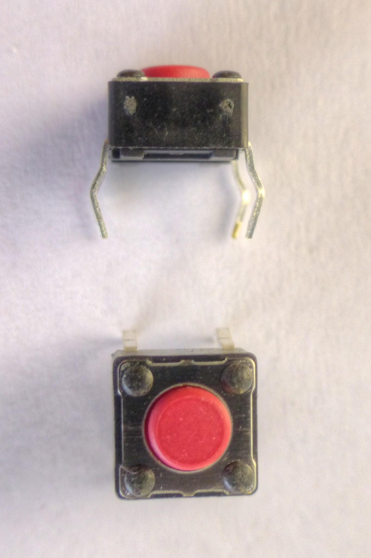
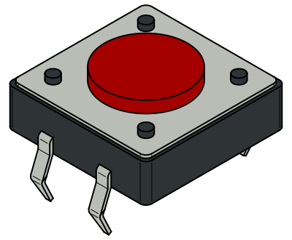
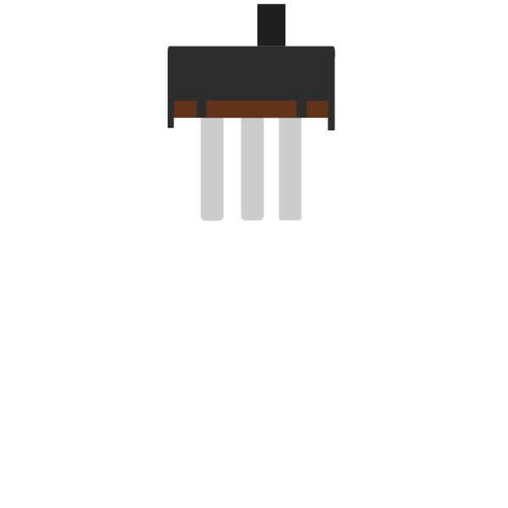
PART 1: PUSH BUTTON and SWITCH
SWITCH
PUSH BUTTON

Slide 3
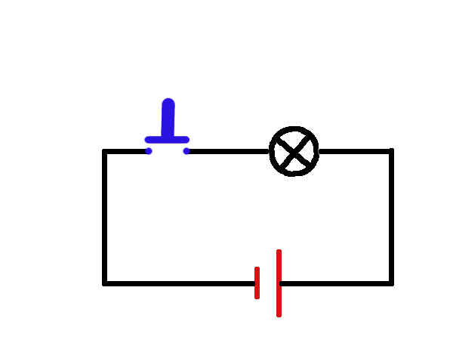
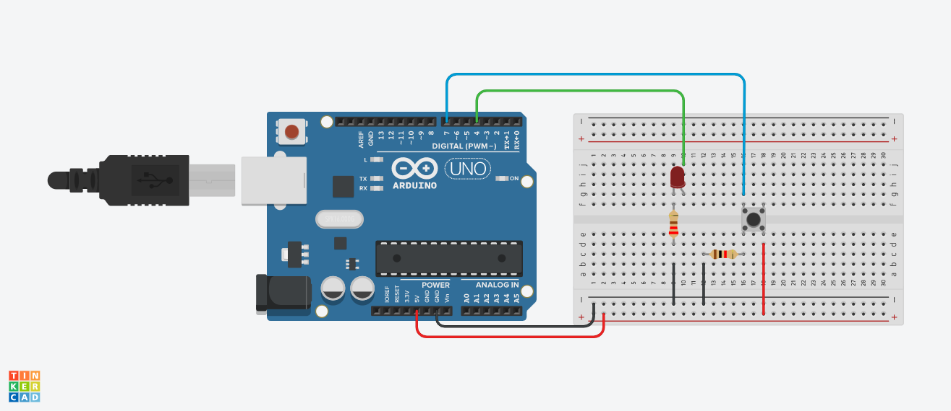
HOW TO USE A PUSH BUTTON
Push button just sends one pulse when pressed.

Slide 4
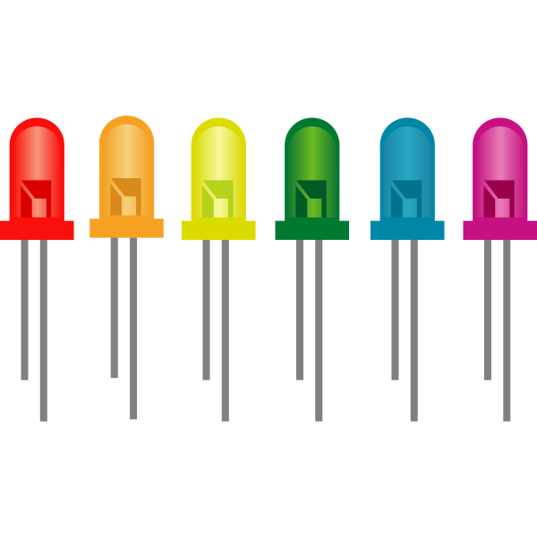
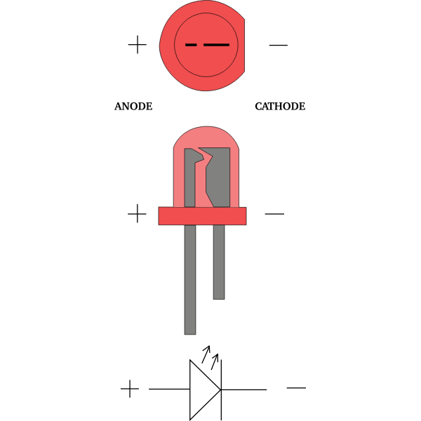
PART 2: LED [LIGHT EMITTING DIODE]

Slide 5
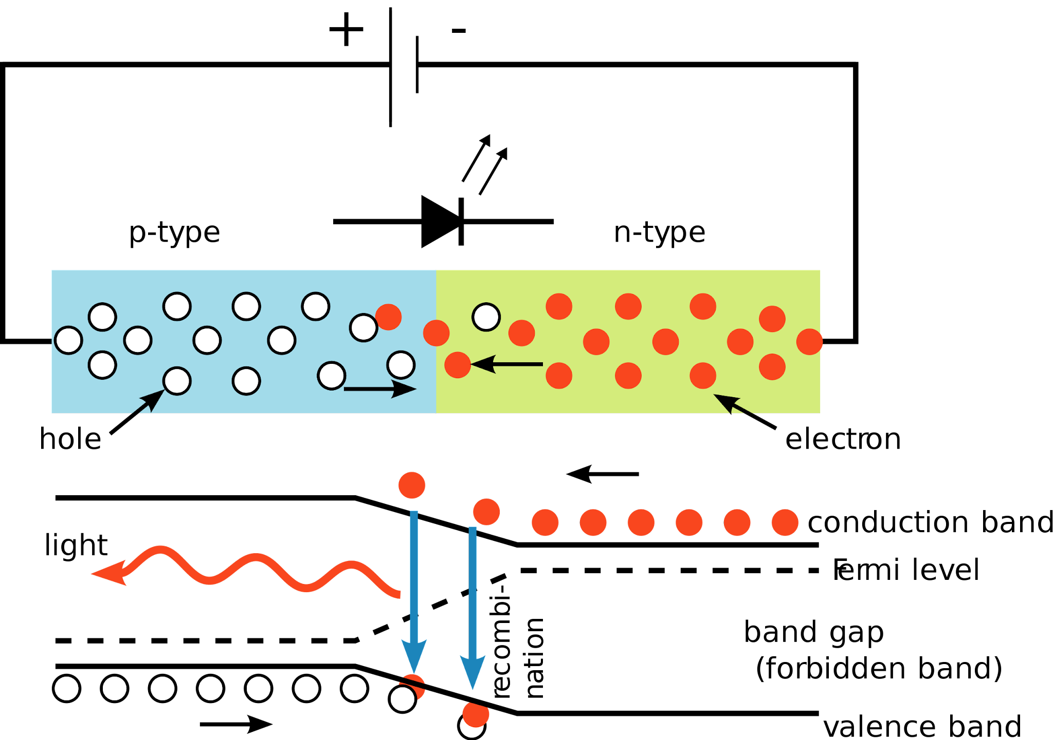
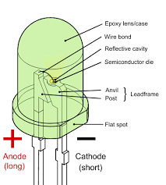
WORKING OF LED
LED is connected in reverse bias,but due to the semiconductor element used
(GaAs,GaP),it radiates heat and light.While other diodes only dissipate heat.

Slide 6
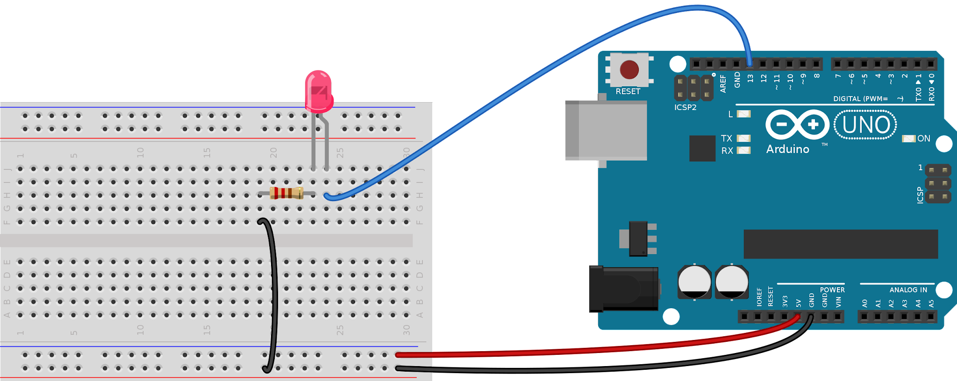
USING A LED
MUST always use a resistor in series with a LED,to limit the current.

Slide 7
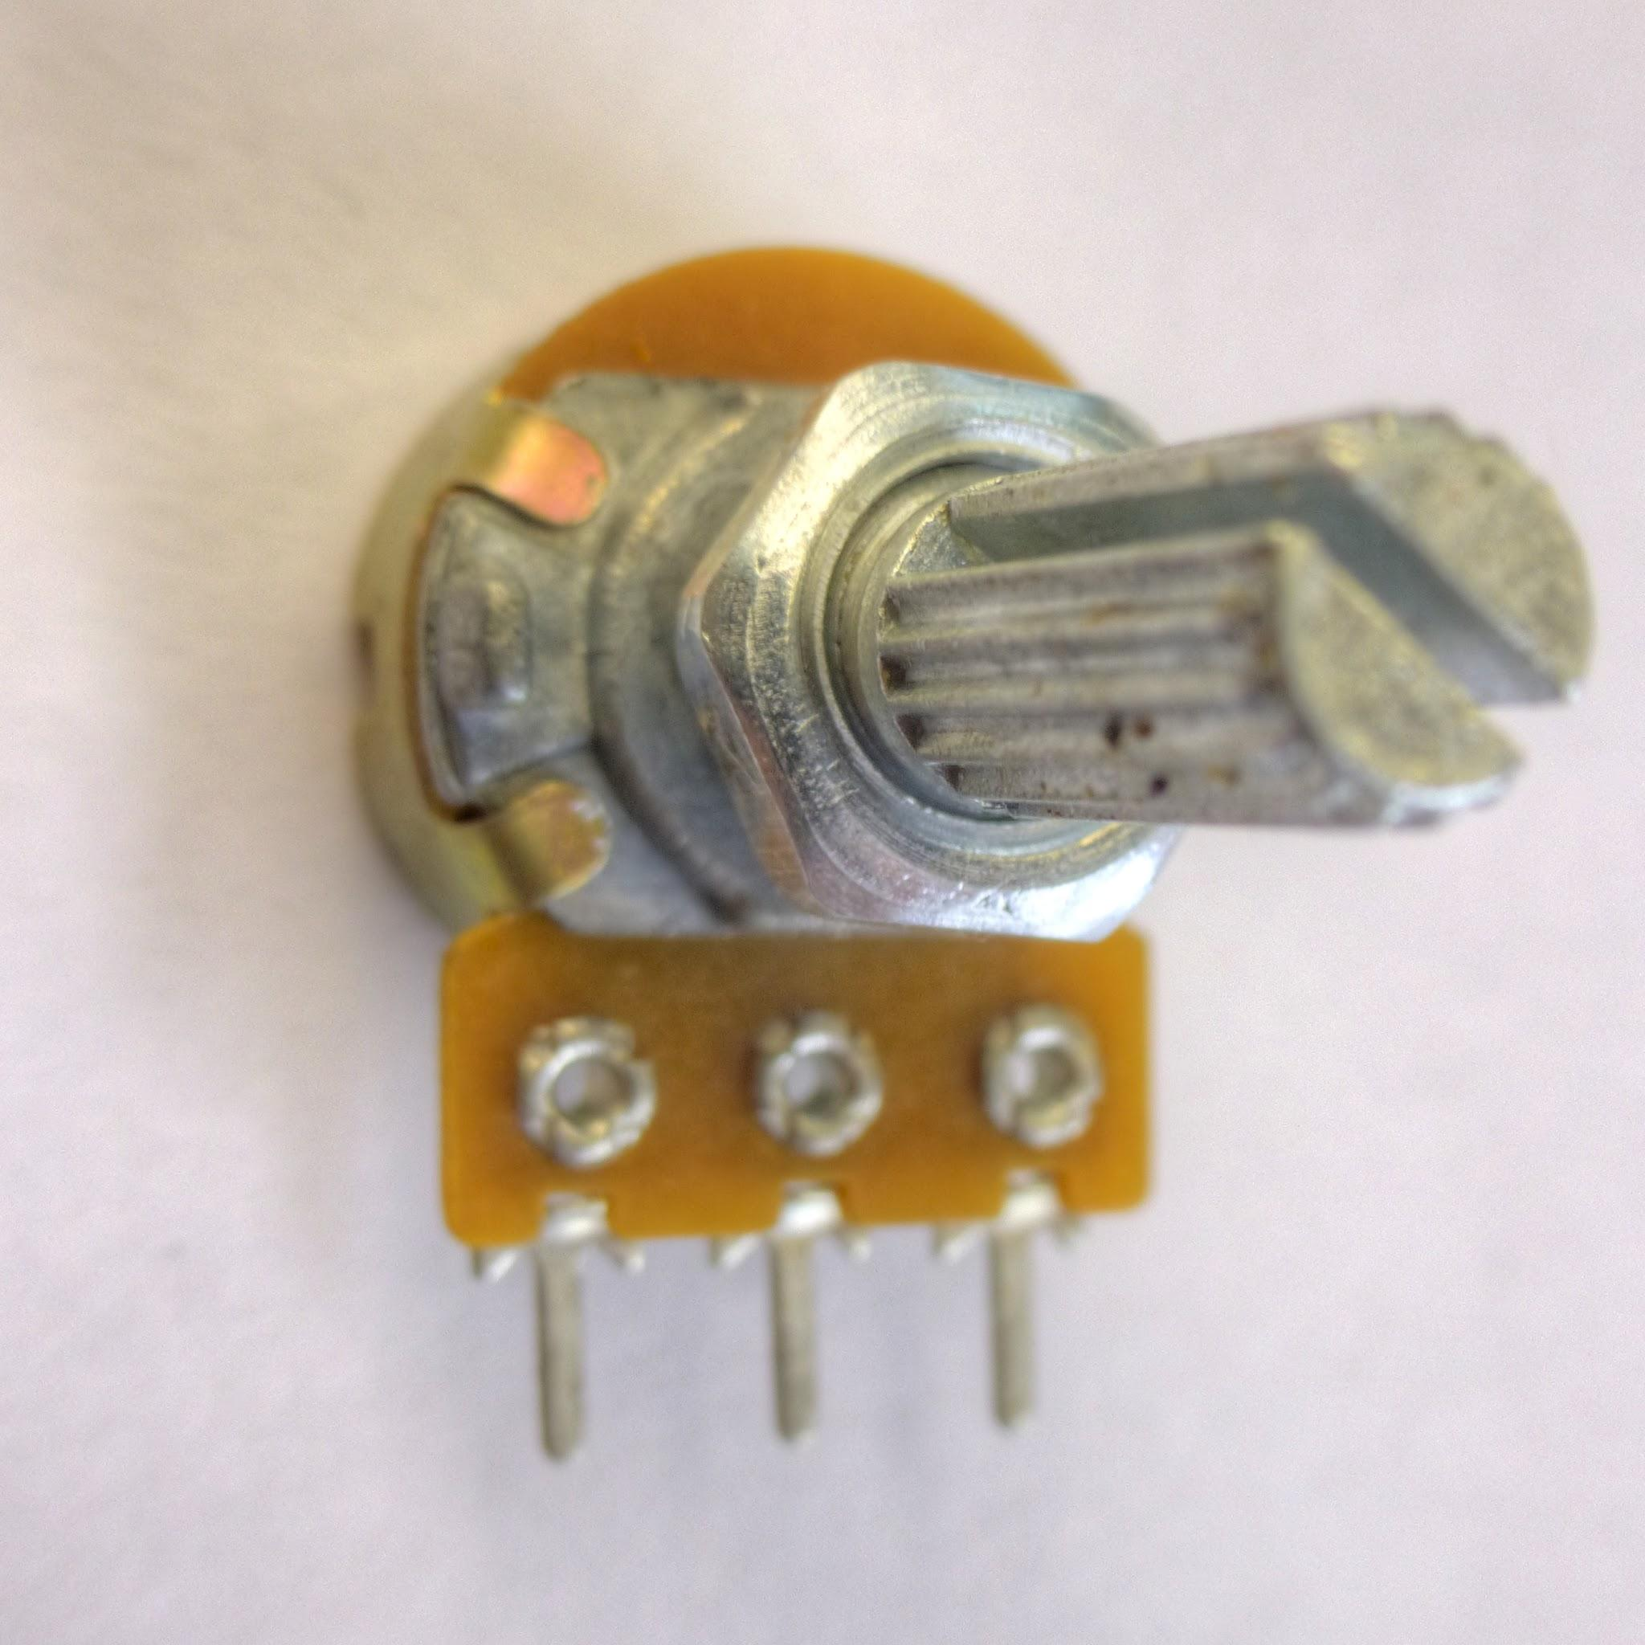
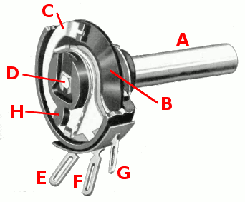
PART 3: POTENTIOMETER

Slide 8
WORKING OF POTENTIOMETER
Potentiometer has a layer of carbon in circular manner.
Depending on the amount of rotation the resistance is offered.

Slide 9
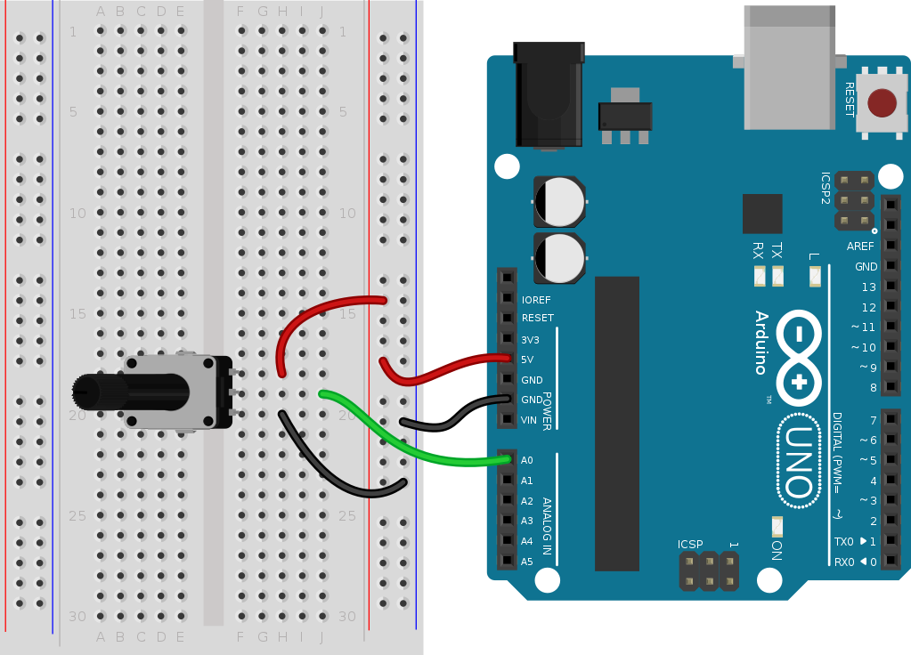
USING A POTENTIOMETER
Must connect one end to Ground and the other end to +Vcc.
The center pin sends the amount of resistance offered in terms of current.

Slide 10
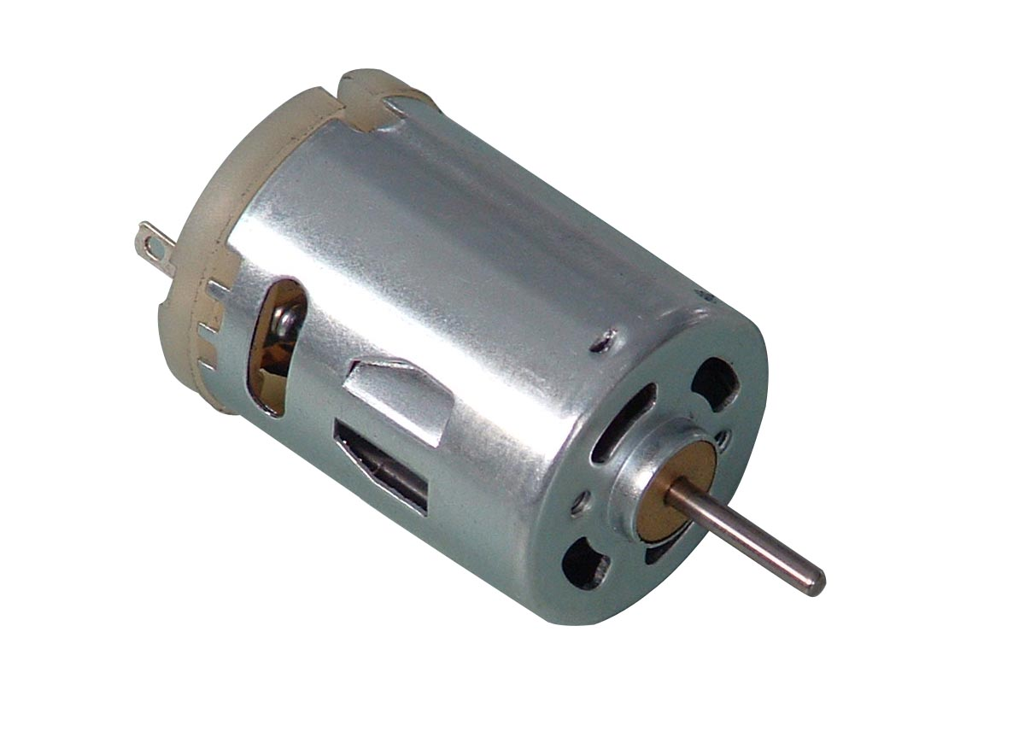
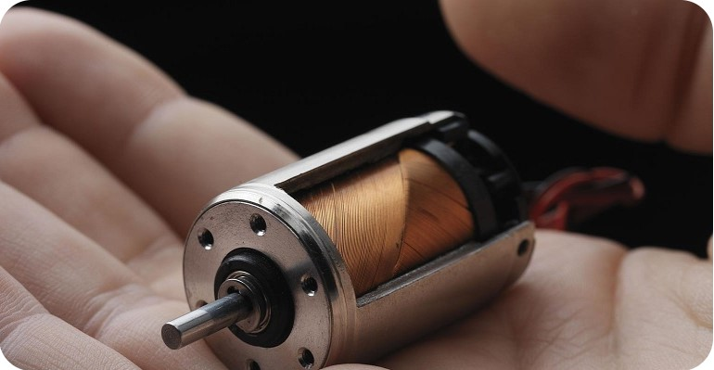
PART 4: DC MOTORS

Slide 11
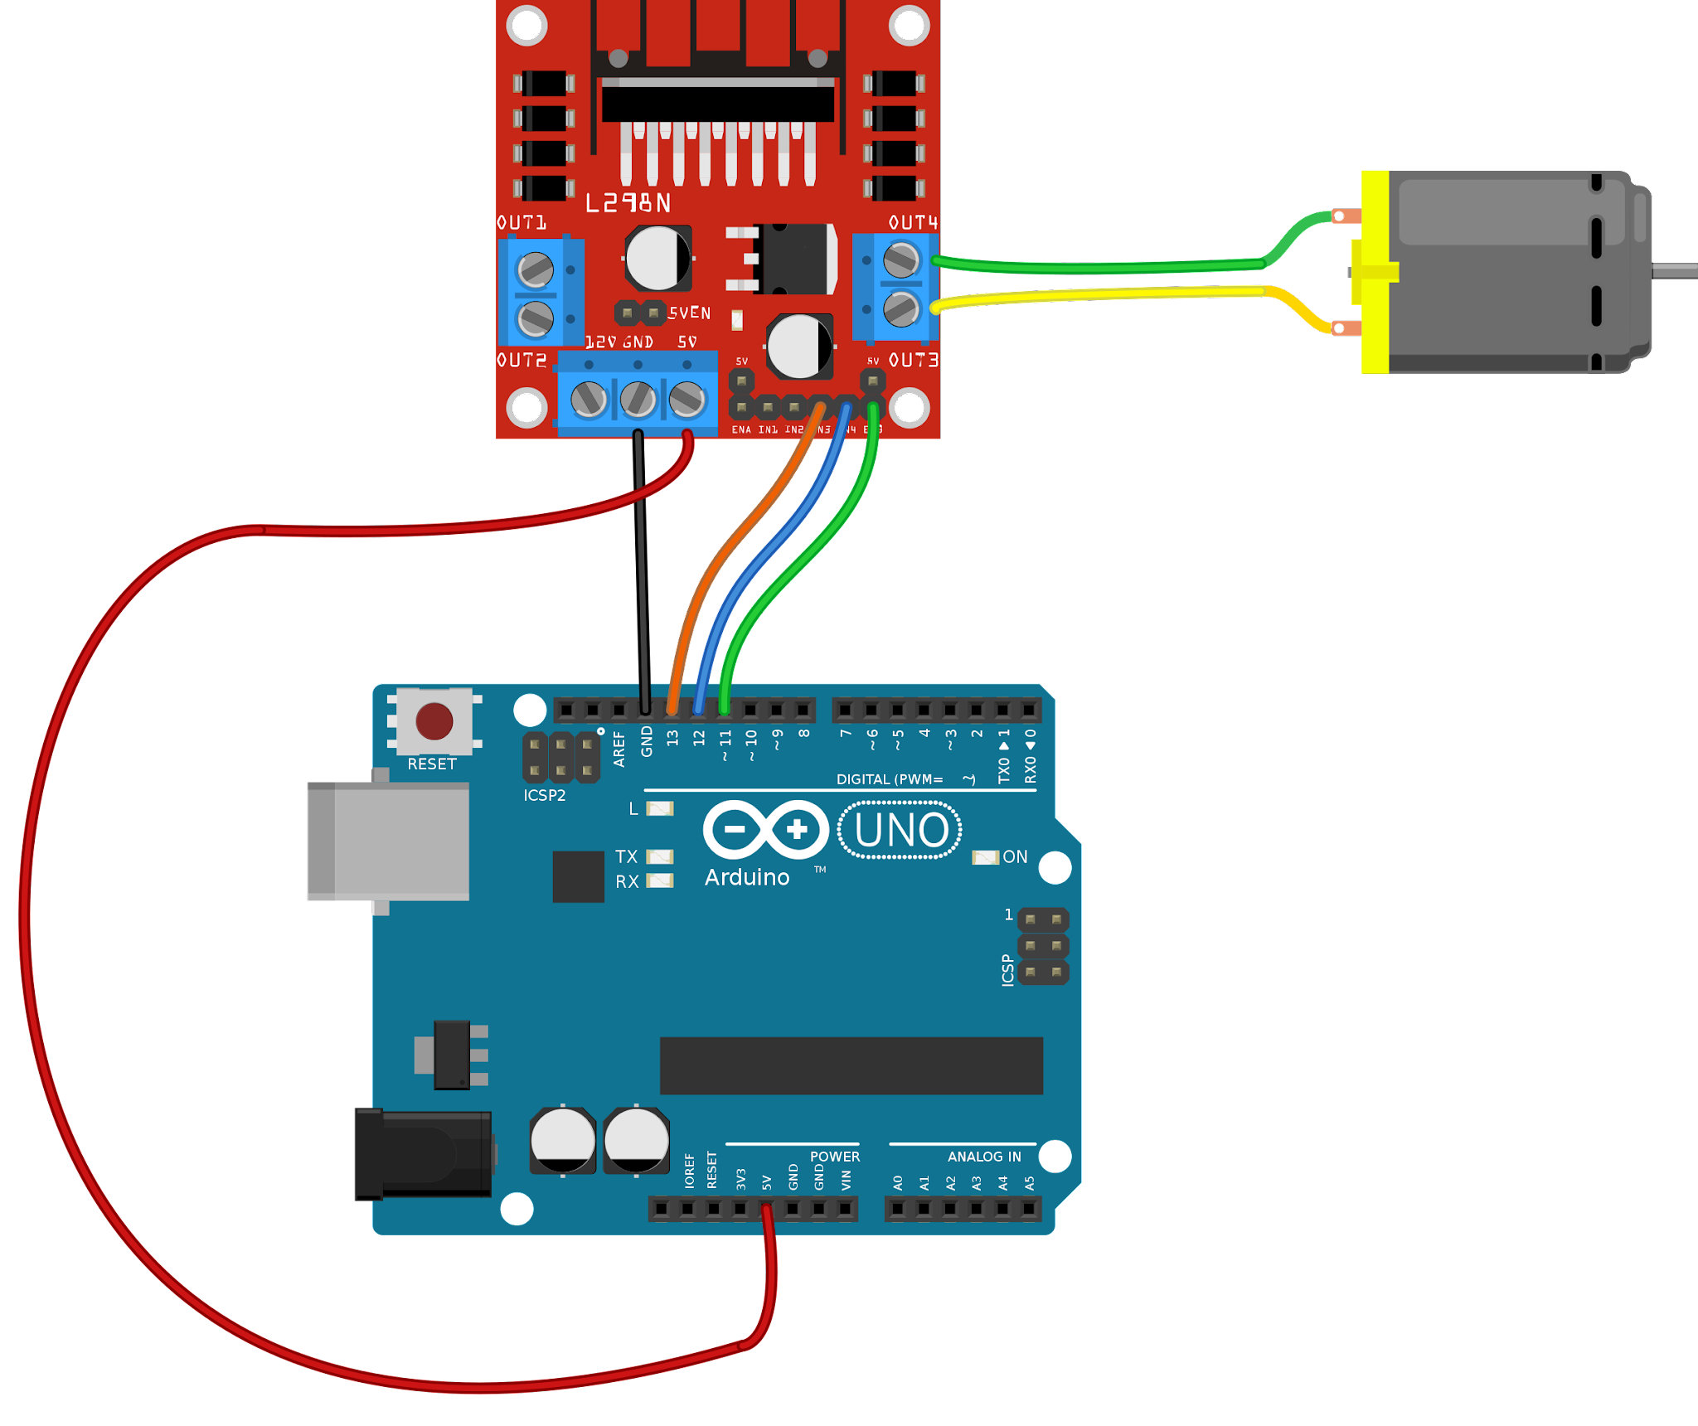
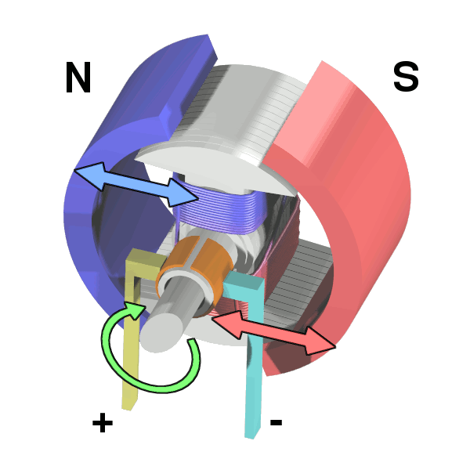
WORKING OF DC MOTOR AND USING IT
DC motors work by applying direct current to the motor's coils, creating a magnetic field that interacts with permanent magnets.
We use a motor driver in order to drive (run) the motor safely without damaging the components

Slide 12
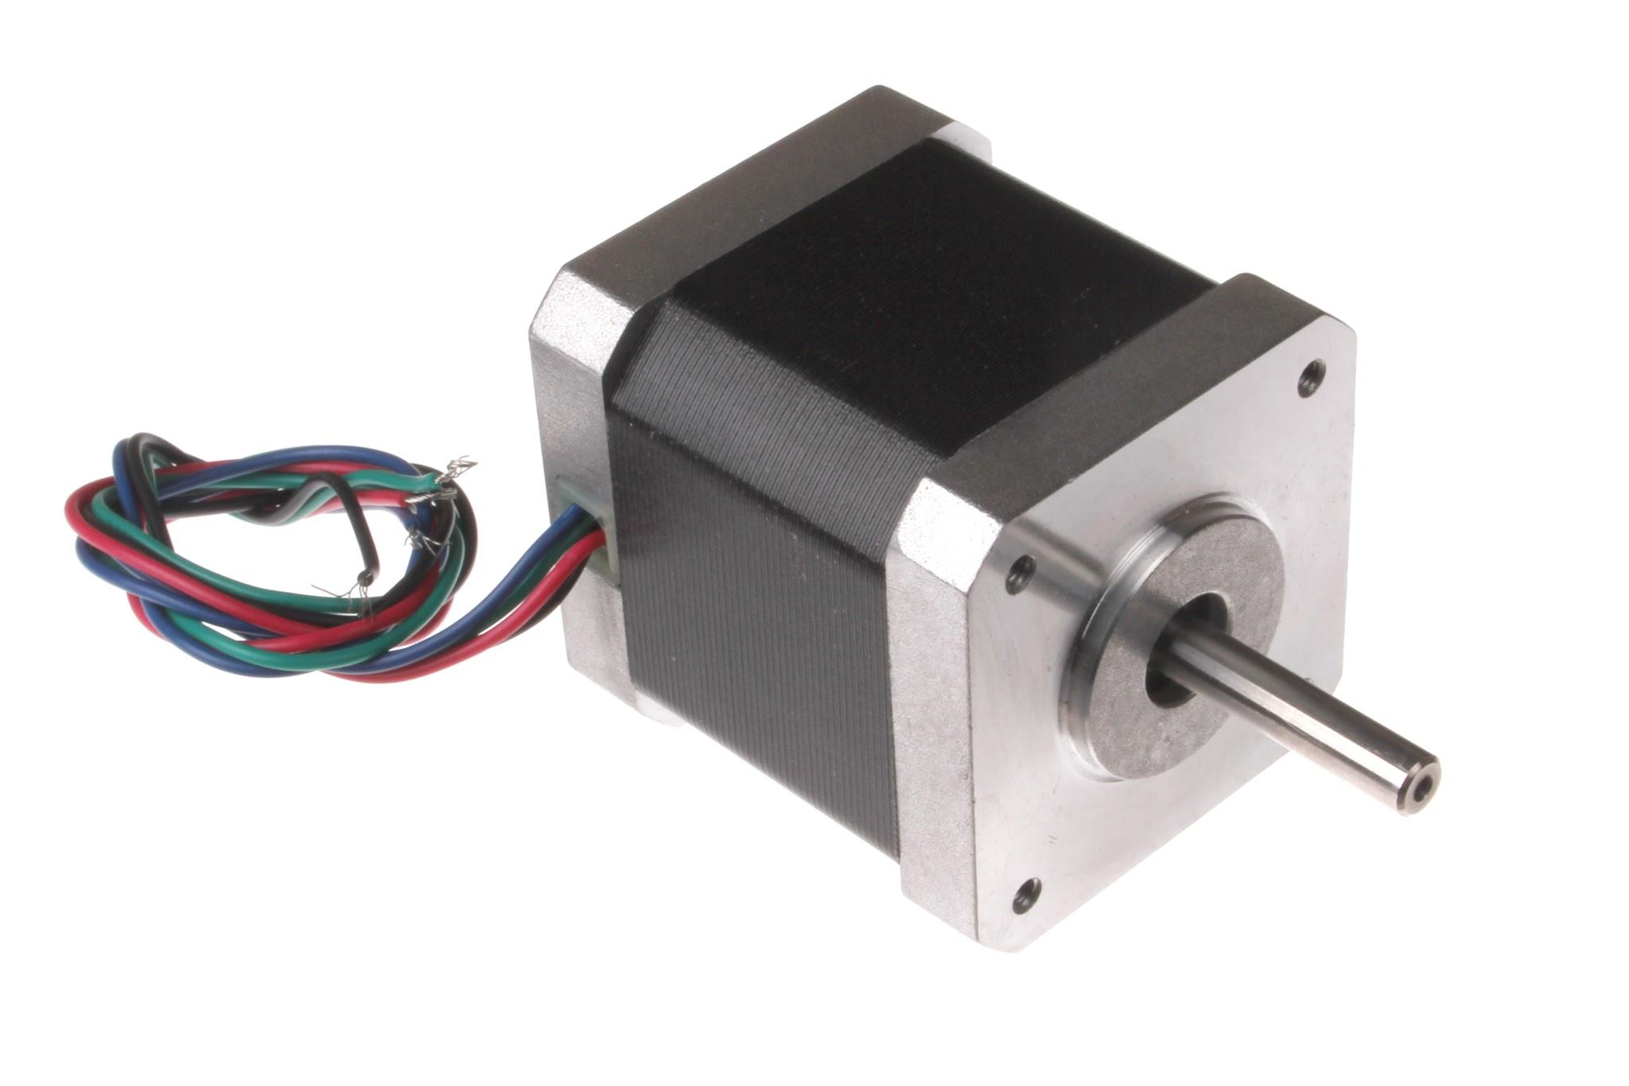
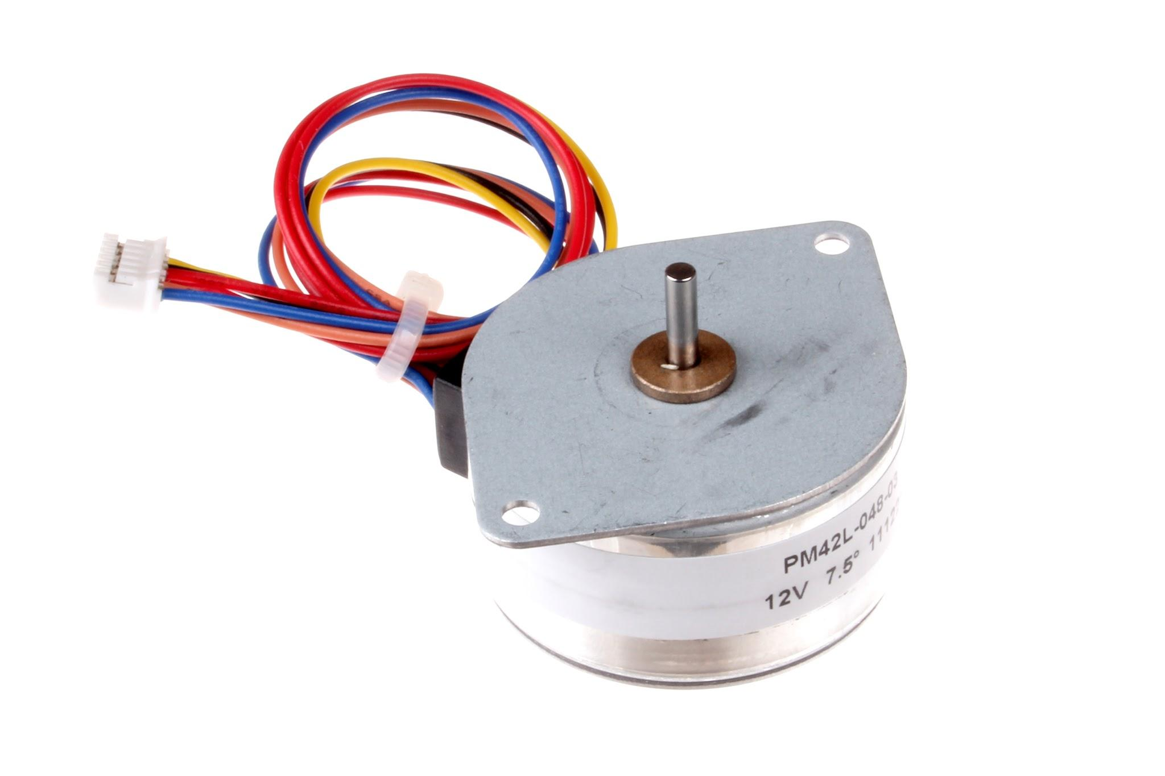
PART 5: STEPPER MOTOR

Slide 13
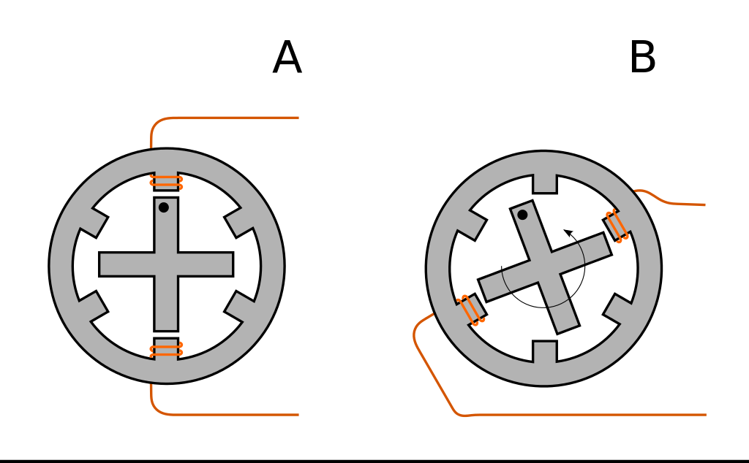
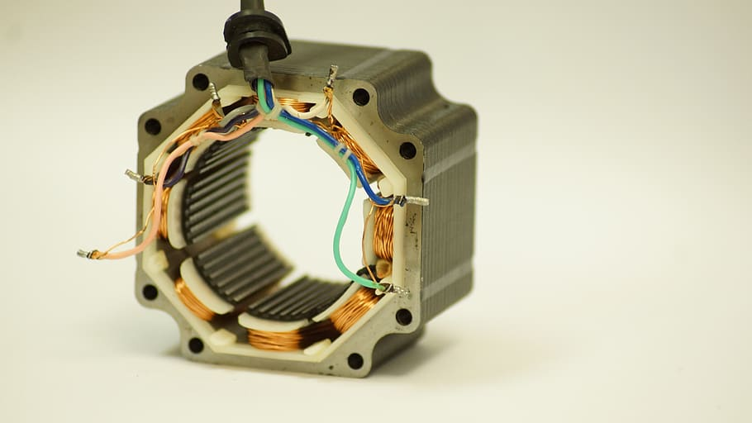
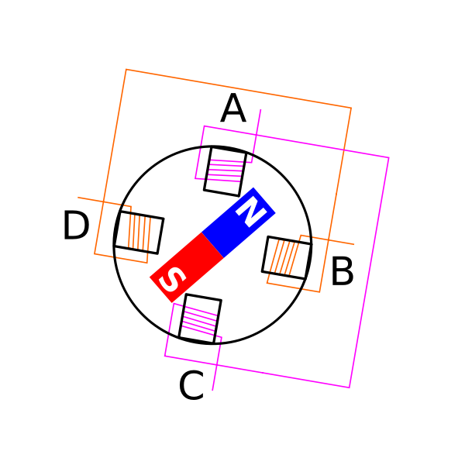
WORKING OF STEPPER MOTOR
A stepper motor converts electrical pulses into precise mechanical motion by sequentially energizing coils in a precise sequence.
Each pulse causes the motor to move a fixed angular distance, allowing for accurate positioning and control.

Slide 14
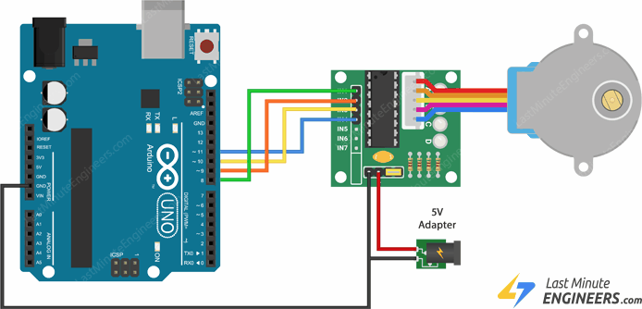
USING A STEPPER MOTOR
We always use the stepper motor with a driver because it provides the necessary current and voltage levels to properly control and drive the motor .
It might also require a separate power supply while working with a lot of components.

Slide 15

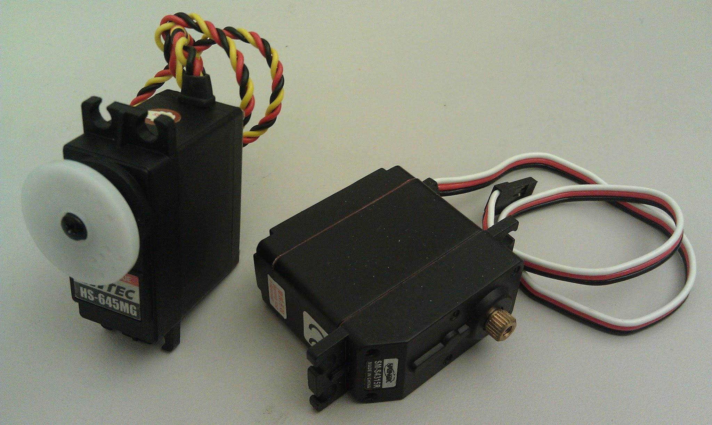
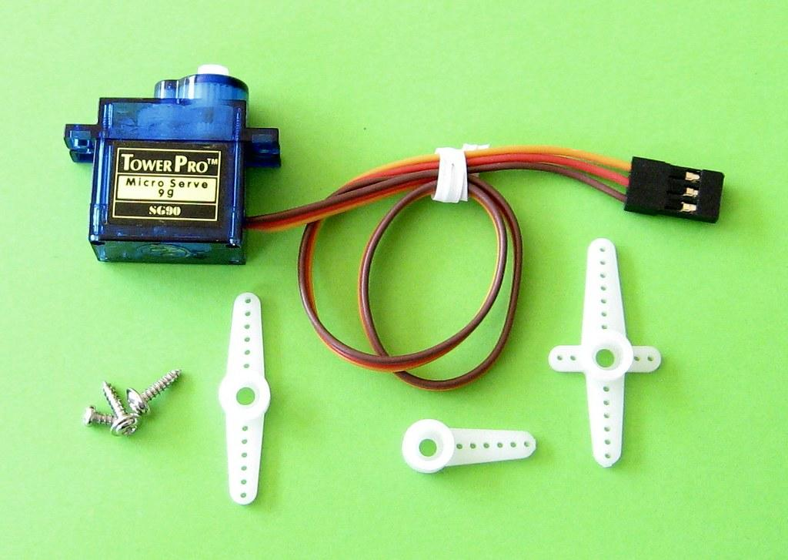
PART 6: SERVO MOTOR

Slide 16
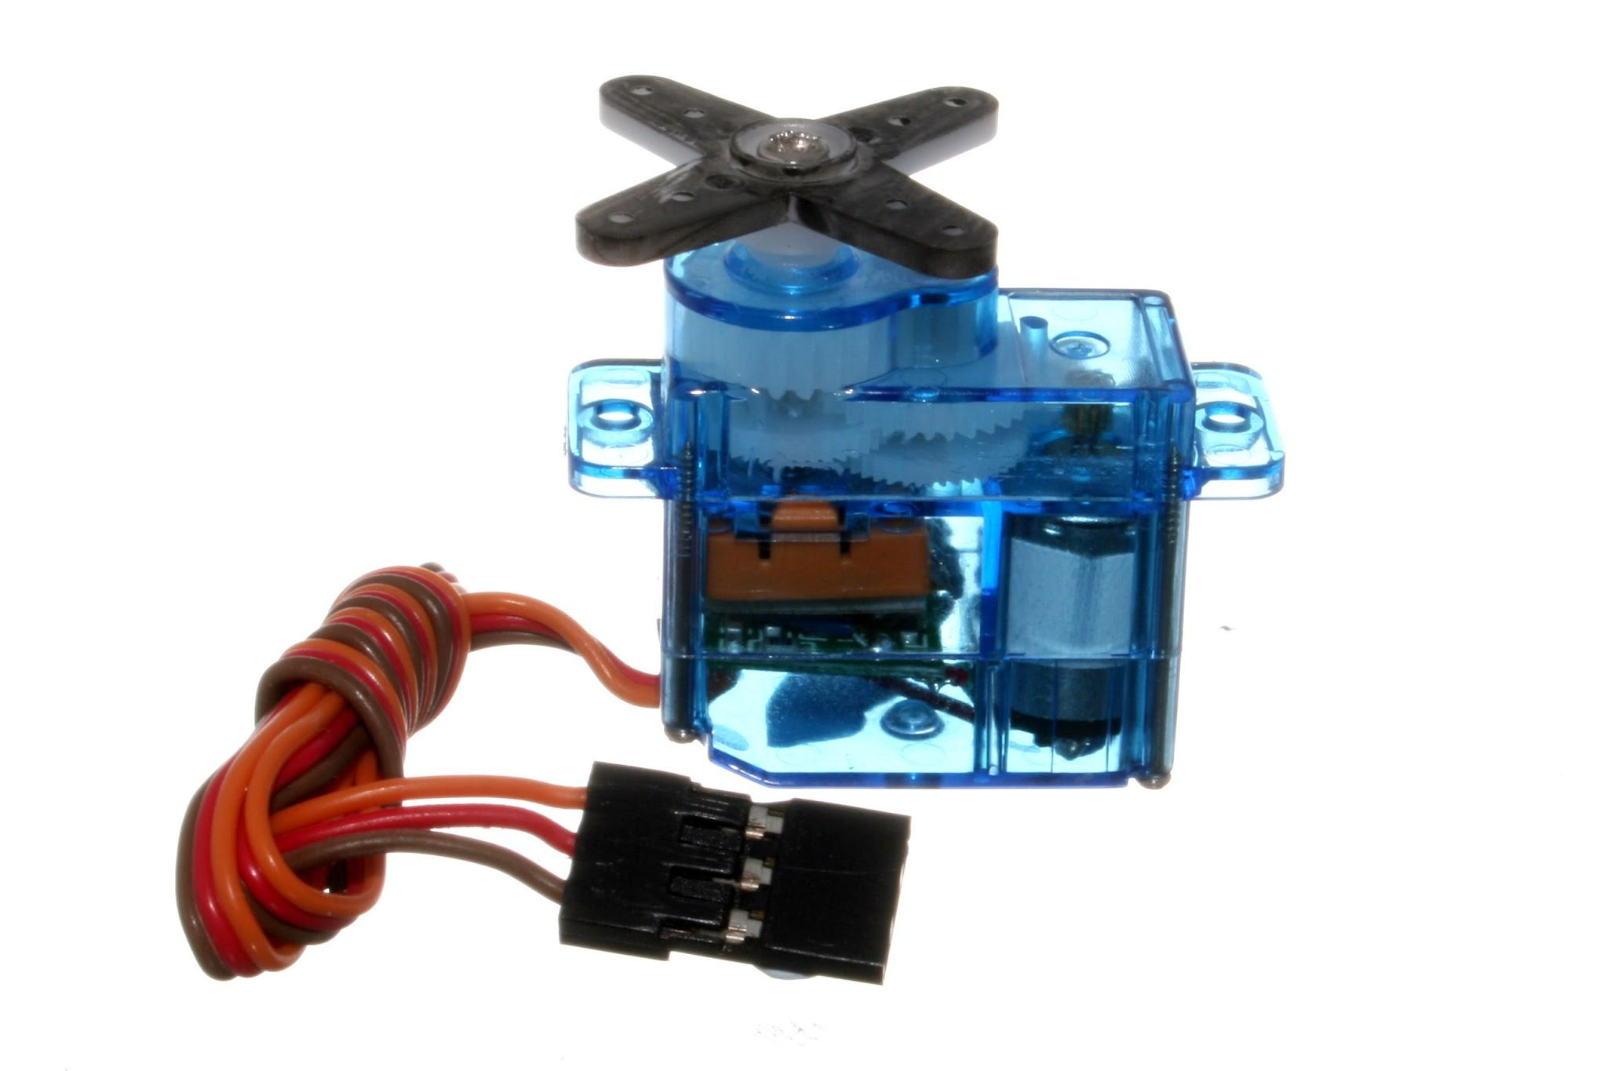
WORKING OF SERVO MOTOR
A servo motor works by receiving a control signal that specifies the desired position, and it uses a built-in feedback mechanism to adjust its rotation accordingly.
It is composed of a motor, gears, and a position-sensing device
(potentiometer) for precise angle control.

Slide 17
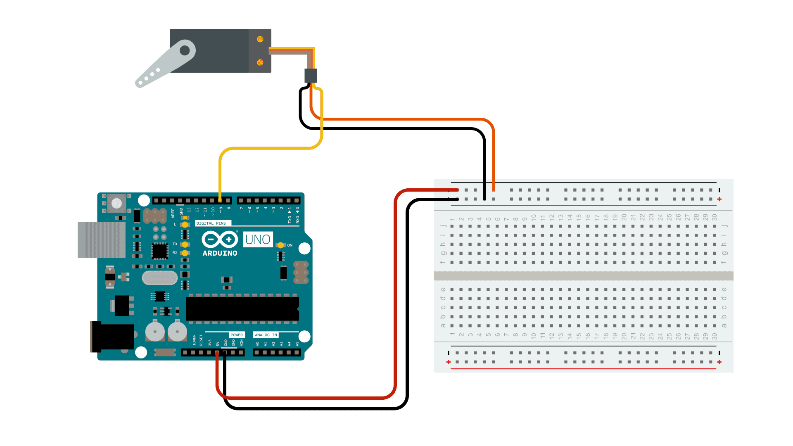
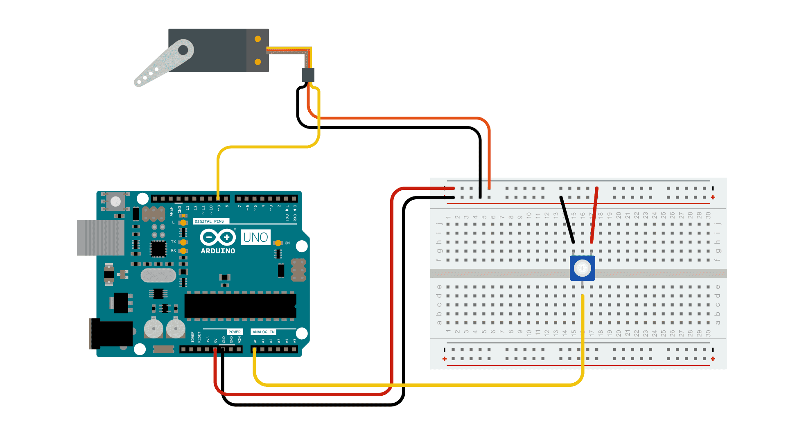
USING A SERVO MOTOR
RED IS +5V. BLACK IS GROUND. ORANGE IS DATA.
SWEEP CIRCUIT
KNOB CIRCUIT

Slide 18
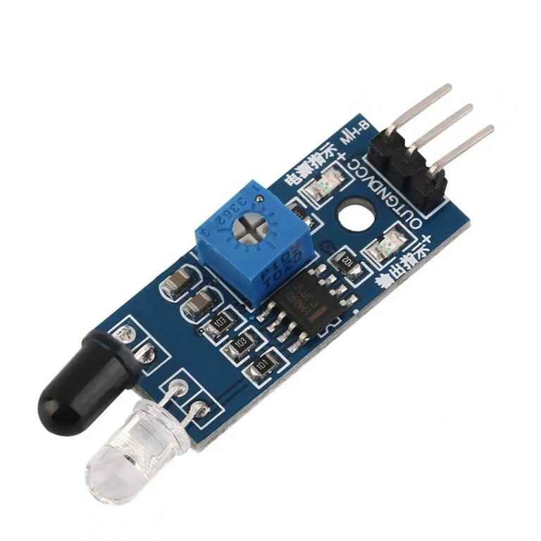
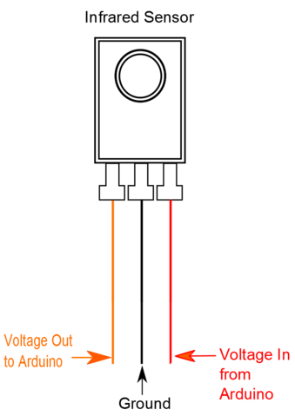
PART 7: IR SENSOR

Slide 19
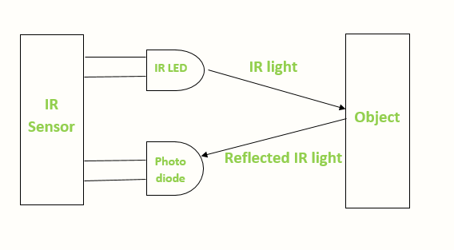
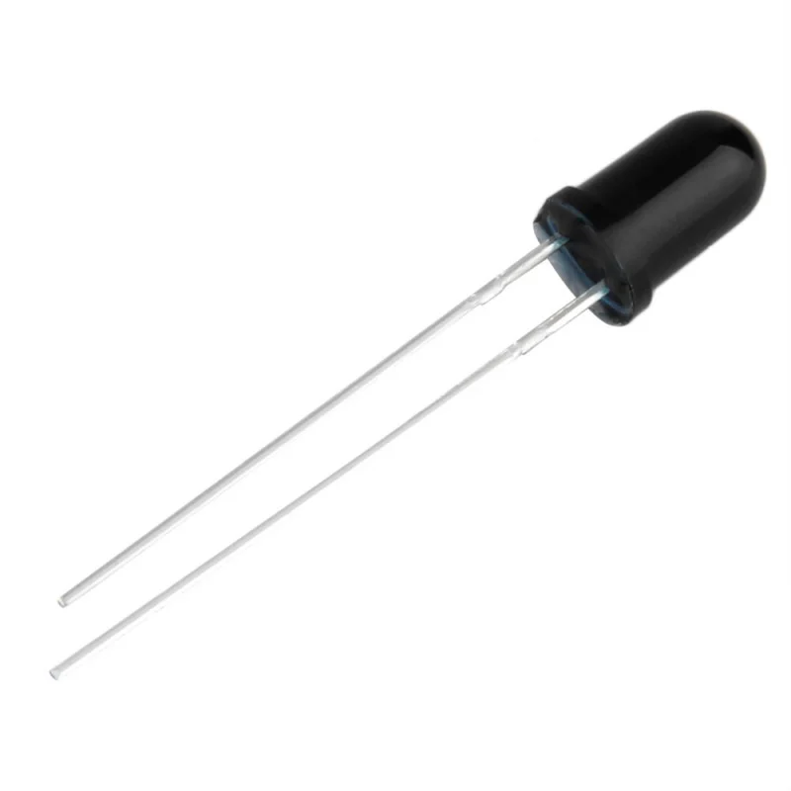
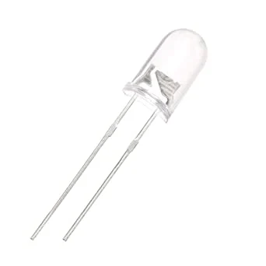
WORKING OF IR SENSOR
An IR (Infrared) sensor detects and measures infrared radiation emitted or reflected by objects.
When an object is in proximity, the sensor's photodiode receives the IR radiation, converting it into an electrical signal, triggering a response, such as activating a switch or sending data to a microcontroller.
IR RECEIVER
(PHOTODIODE)
IR TRANSMITTER

Slide 20
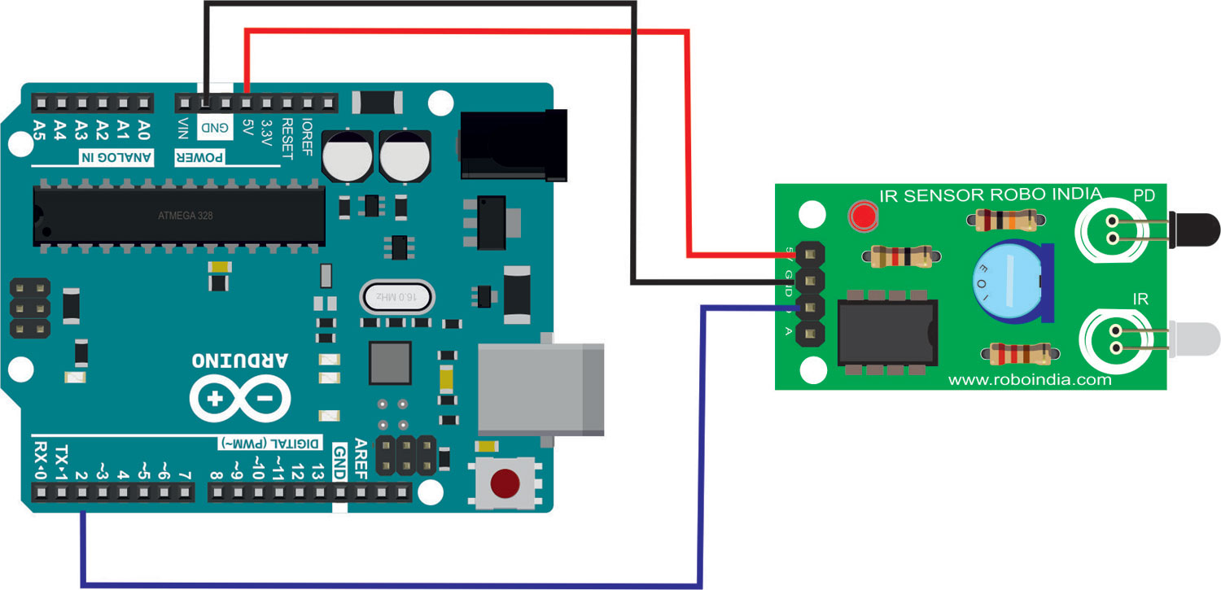
USING A IR SENSOR
Vcc = +5V
GND = GND
OUT = DIGITAL 2

Slide 21
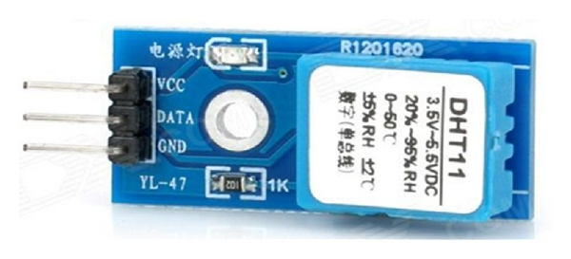
PART 8: DHT 11(TEMPERATURE AND HUMIDITY SENSOR)

Slide 22
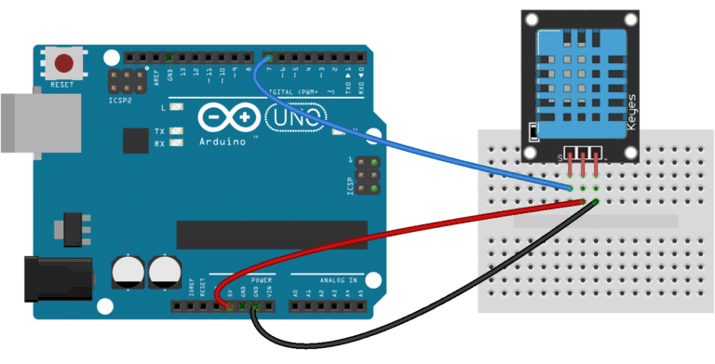
USING A DHT11 SENSOR
Vcc(+) = 5V
GND(-) =GND
OUT =DIGITAL PIN 7

Slide 23
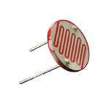
PART 9: LDR (LIGHT DEPENDENT RESISTOR)

Slide 24
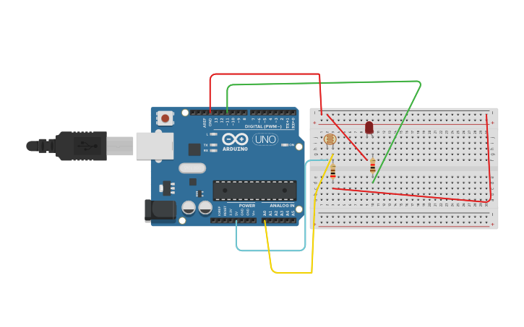
WORKING AND USING THE LDR
An LDR (Light Dependent Resistor) changes its resistance based on the amount of light falling on it, decreasing resistance in bright light and increasing in darkness.

Slide 25
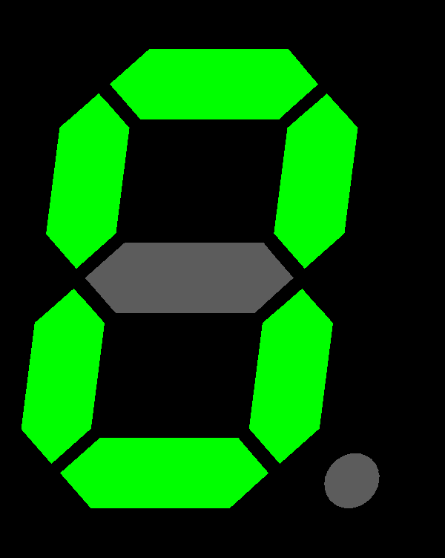
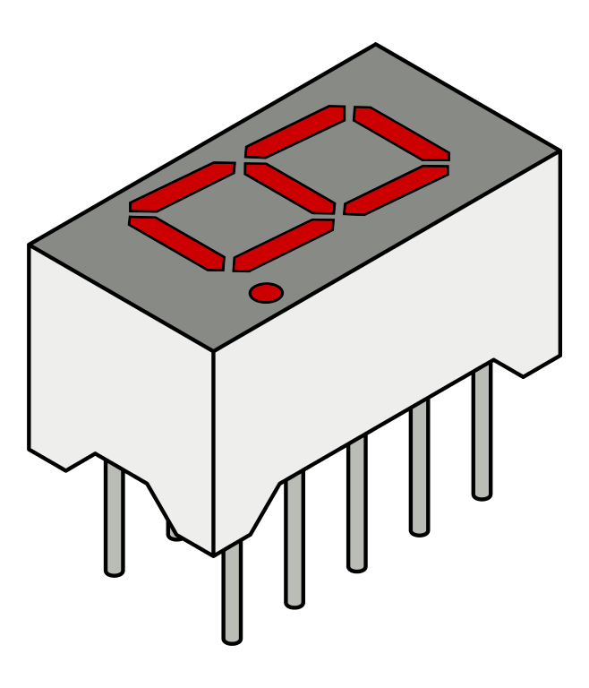
PART 10: SEVEN SEGMENT DISPLAY

Slide 26
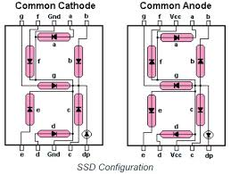
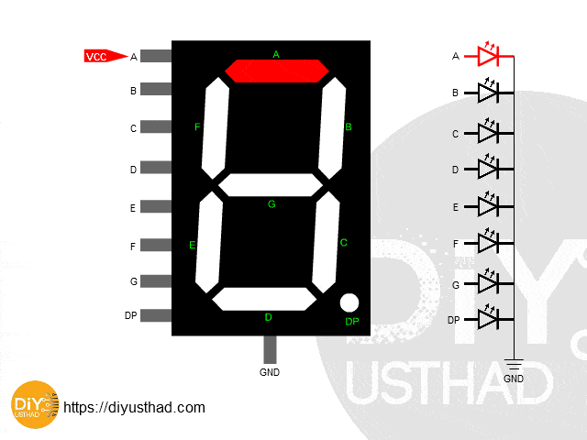
WORKING OF SEVEN SEGMENT DISPLAY
A seven-segment display shows numeric digits (0-9) and some characters using seven LEDs arranged in a specific pattern, with each LED representing one segment of the digit or character

Slide 27
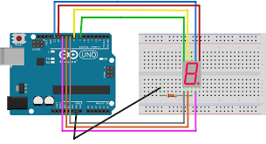
USING A SEVEN SEGMENT DISPLAY
Notes:
Addicore library

Slide 28
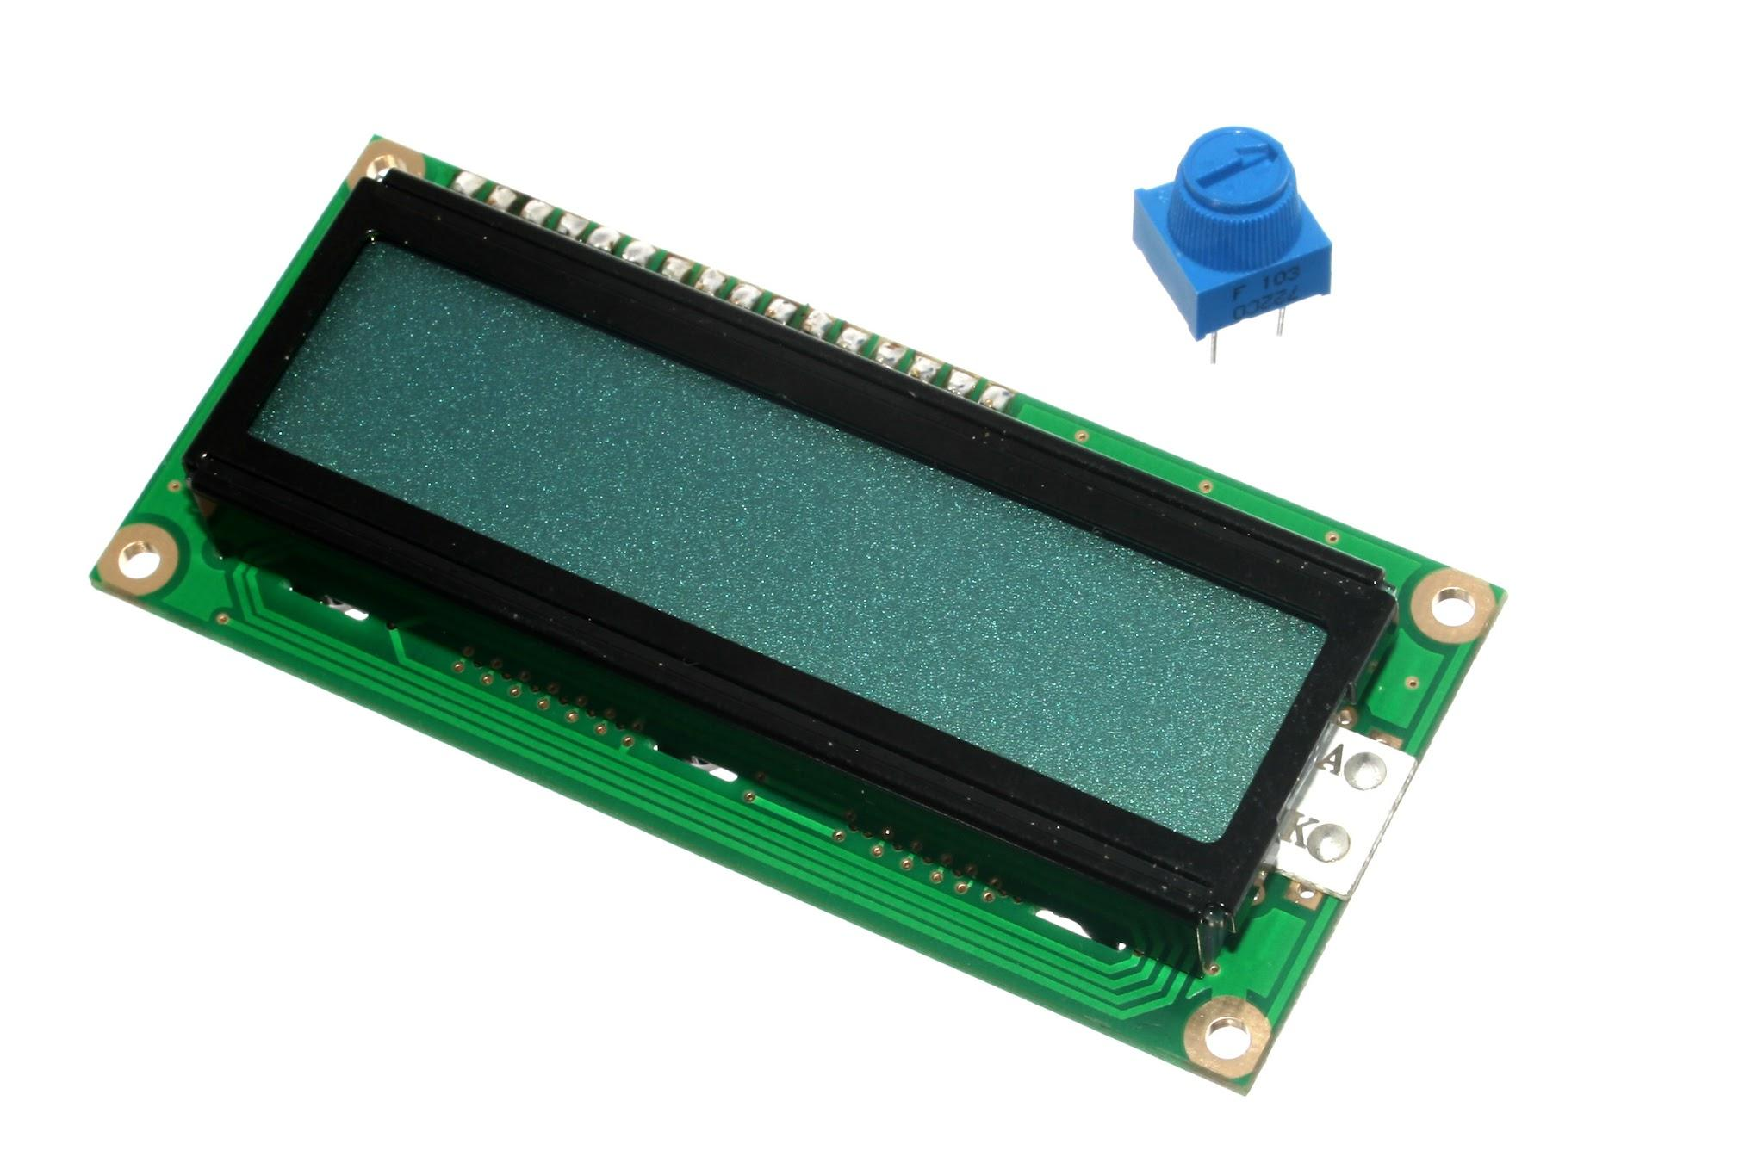
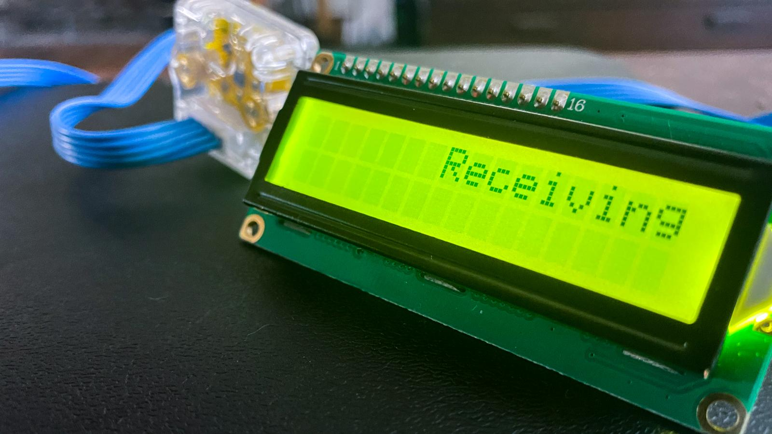
PART 11: LCD

Slide 29
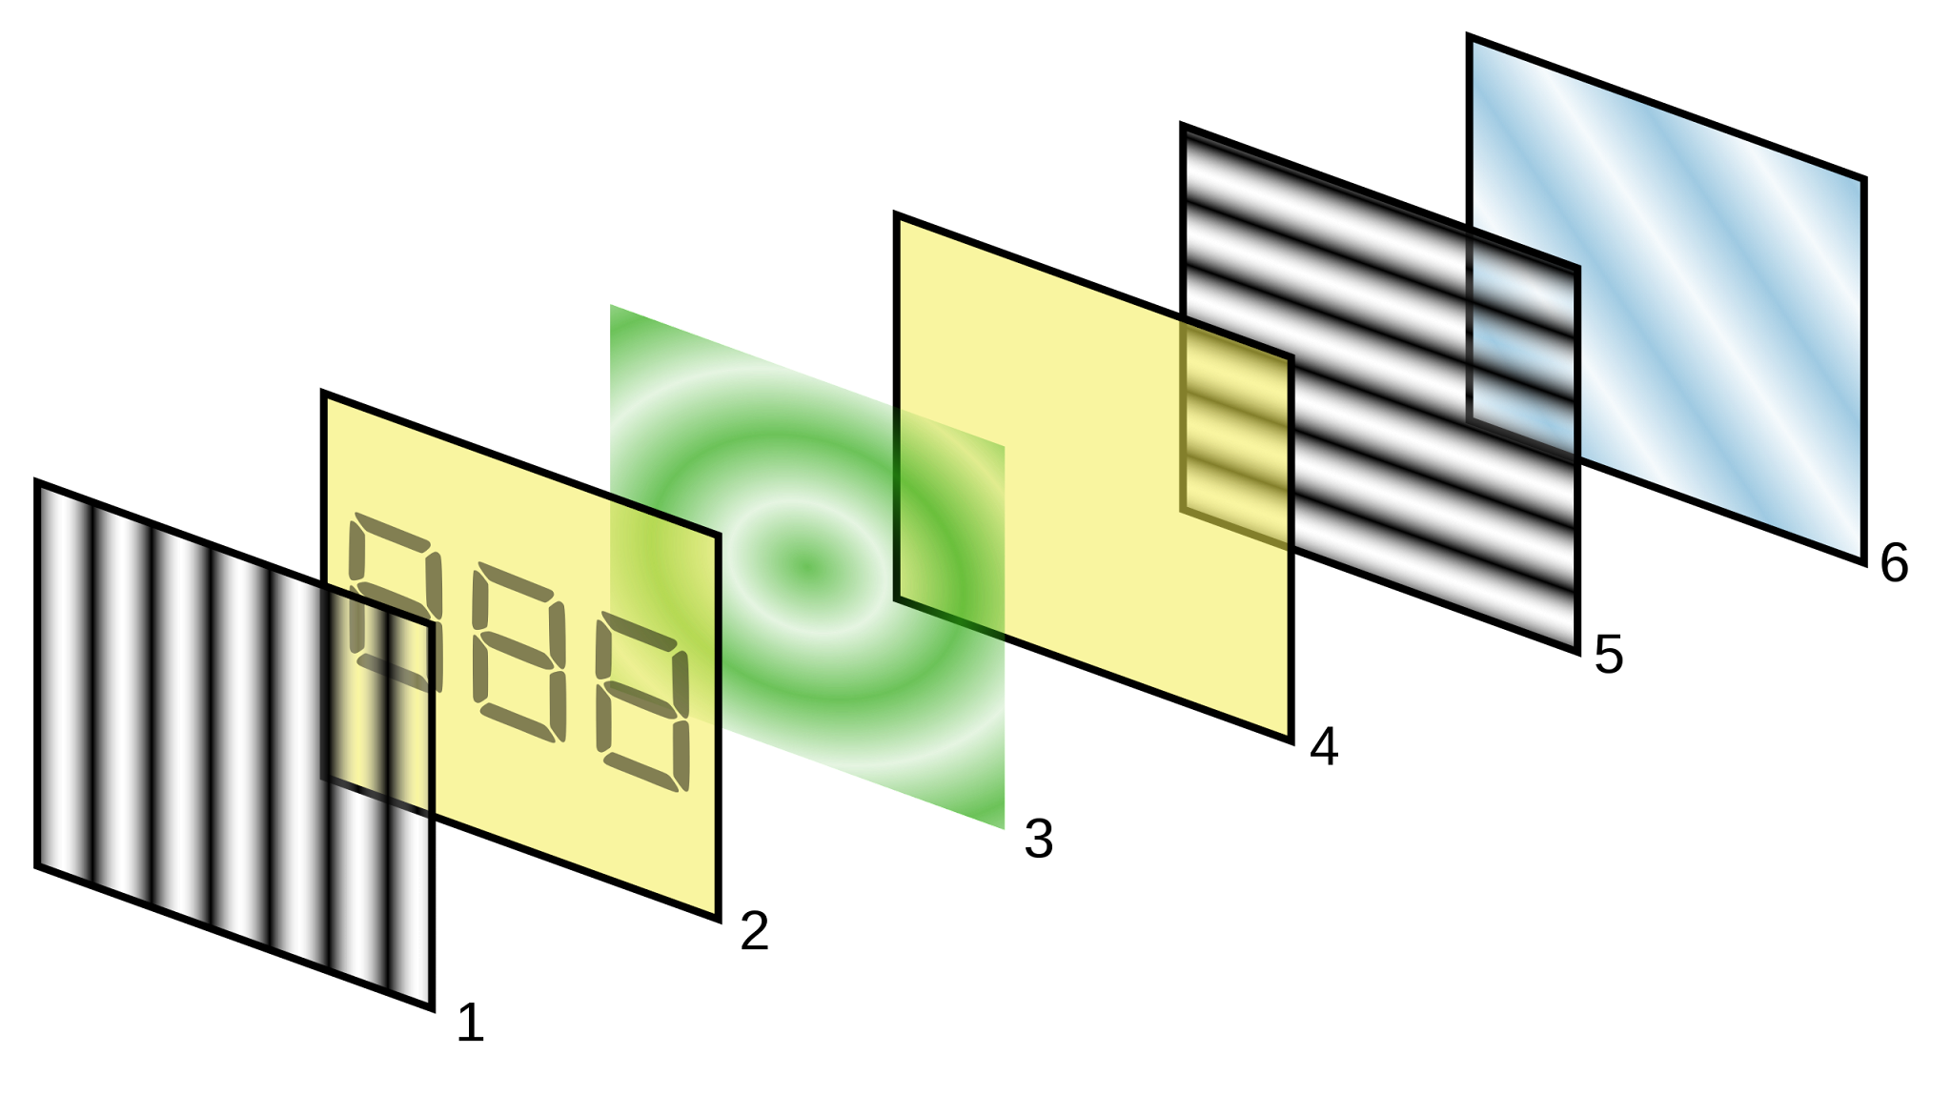
WORKING OF LCD
An LCD (Liquid Crystal Display) is a flat-panel technology that uses liquid crystals to display information.
When an electric current is applied, the liquid crystals align to let or block light, creating text or images.

Slide 30
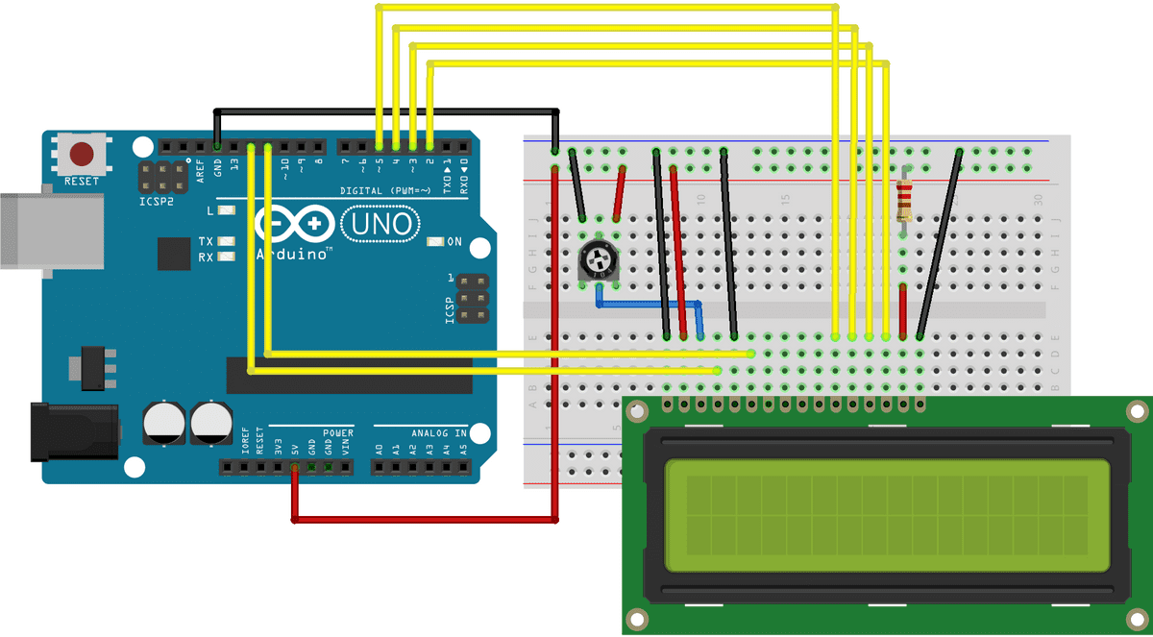
USING THE LCD

Slide 31
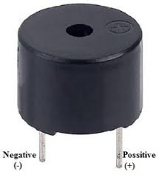
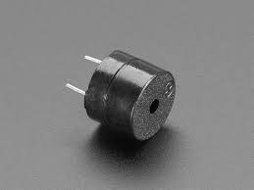
PART 12: BUZZER

Slide 32
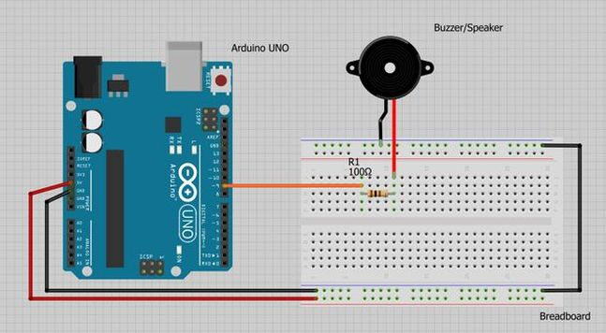

WORKING AND USING A BUZZER
A buzzer generates sound when an electric current passes through it, causing a diaphragm to vibrate and produce an audible tone or sound.

Slide 33
THANK
YOU

